Slide 1
A Nonconvex Splitting Method for Symmetric Nonnegative Matrix Factorization: Convergence Analysis and Optimality
Authors: Sontao Lu, Mingyi Hong, Zhengdao Wang
Haoxuan Yang
Colorado school of Mines
Mar 18 2019

Slide 2
Outline
Introduction
Method
Convergence and convergence rate
Results
Conclusion

Slide 3
Introduction
Nonnegative matrix factorization (NMF) refers to factoring a given matrix into the product of two matrices whose entries are all nonnegative.
When further requiring that the two factors are identical after transposition, NMF becomes the so-called symmetric nonnegative matrix factorization (SymNMF).
It has been widely used in graph clustering, image segmentation, etc..

Slide 4

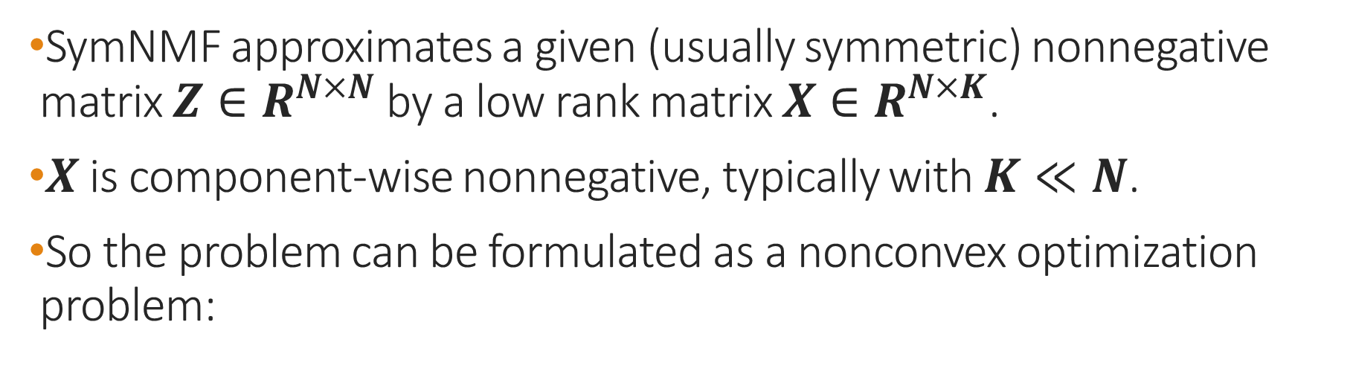
Introduction
SymNMF approximates a given (usually symmetric) nonnegative matrix ${Z∈R}^{N×N}$ by a low rank matrix ${X∈R}^{N×K}$.
$X$ is component-wise nonnegative, typically with $K≪N$.
So the problem can be formulated as a nonconvex optimization problem:

Slide 5
Introduction
Several related works focusing on customized algorithms for SymNMF such as:
Related ANLS-based method: based on the assumption that there exists an exact symmetric factorization, otherwise it may not converge to Karush-Kuhn-Tucker(KKT) points.
A multiplicative update method for symNMF: the algorithm lacks convergence guarantees and has a much slower convergence speed.

Slide 6
Introduction
Some popular methods for NMF are based on alternating direction method of multipliers (ADMM) without imposing symmetry in the factors, so the convergence of ADMM for SymNMF is still open in the literature.

Slide 7


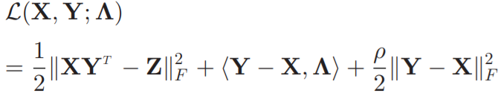
Method
We first rewrite SymNMF as follow:
Then construct the augmented Lagrangain:

Slide 8
Method
The main difficulty is that well-known ADMM method only works for convex problems. And recent results that analyze ADMM for nonconvex problems do not apply either, because in those works, basic requirements are:
The objective function is separable over the block variables
The smooth part of the augmented Lagrangian has Lipschitz continuous gradient with respect to all variable blocks.
Unfortunately, neither of these conditions are satisfied in our problem.

Slide 9
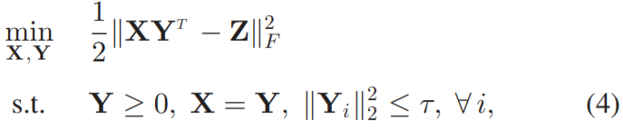

Method
So we start by considering the following reformulation of problem:
where is some given constant.
It can be checked that when is sufficiently large (we will talk about it later), problem (1) and (4) have the same KKT points.

Slide 10
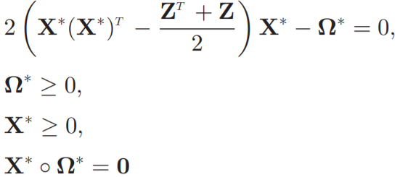


Method
Then the KKT conditions of problem (1) are given by:
Where denotes the dual matrix for the constraint
and denotes the Hadamard product.

Slide 11
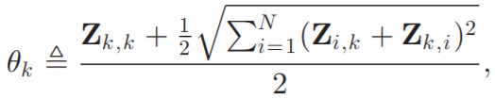
Method
Lemma2:
Suppose where
then the KKT points of problem (1) and the KKT points of problem (4) have a one-to-one correspondence.
Proof: see section VII-B

Slide 12
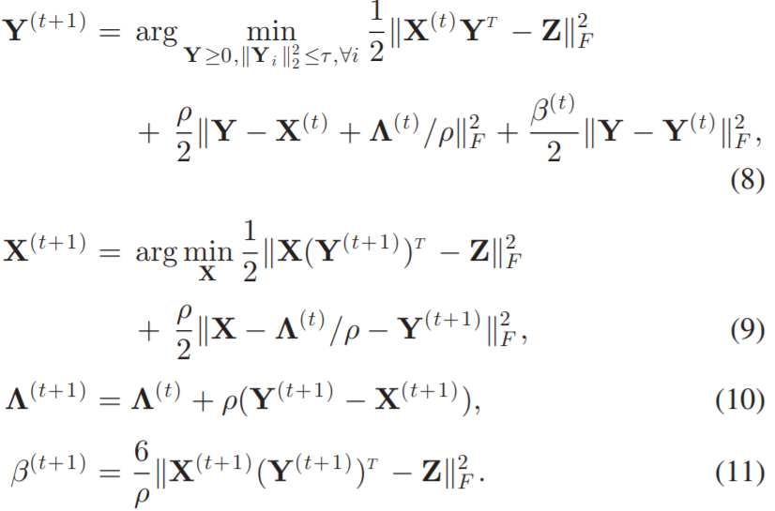
Method
We propose NS-SymNMF algorithm which alternates between the primal updates of variables X and Y, and the dual updates for .

Slide 13


Method
Notice that this algorithm seems very close to the standard ADMM method applied to problem (4). But the key difference is the use of proximal term multiplied by an iteration dependent penalty parameter , whose value is proportional to the objective value.
If the algorithm converges to a solution with a small objective value, then parameter will vanish in the limit.
Introducing such proximal term is one of the main novelty of the algorithm, and it is crucial to guarantee the convergence.

Slide 14



Convergence and convergence rate
The first main result is that when the penalty parameter is sufficiently large, the algorithm converges globally to the set of KKT points of problem (1).
Theorem 1: Suppose the is satisfied, then the equality constraint is satisfied in the limit The sequence generated by the algorithm is bounded. And every limit point of the sequence is a KKT point of problem (1).
Proof: see section VII-C.

Slide 15

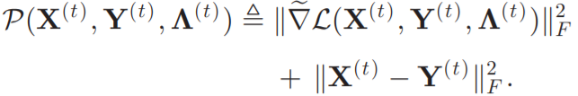



Convergence and convergence rate
The second main result is that the function goes to zero in a sublinear manner, where is a quantity to measure the progress of the algorithm.
Theorem 2: For a given small constant , let denote the iteration index satisfying the inequality Then there exists some constant C > 0 such that
Proof: see section VII-D
The result indicates that it takes iterations for to be less than .

Slide 16


Convergence and convergence rate
Since the problem (1) is not convex, the KKT points obtained by the algorithm could be different from the global optimal solutions. We provide an easily checkable sufficient condition to ensure that a KKT point is also a globally optimal solution.
Theorem 3: Suppose that is a KKT point of problem (1). Then is also a global optimal point if the following is satisfied
Proof: see section VII-E

Slide 17





Convergence and convergence rate
The previous condition is only a sufficient condition and hence may be difficult to satisfy in practice. We provide a milder condition which ensure that a KKT point is locally optimal.
Theorem 4: Suppose that is a KKT point of problem (1). Define a block matrix
whose (m,n)th block is a matrix of size as follows:
where is the Kronecker delta function, and denotes the m-th column of . If there exists some > 0 such that , then is a strict local minimum solution of problem (1).
Proof: see section VII-F
Observations show that the solution satisfy this condition with high probability.

Slide 18
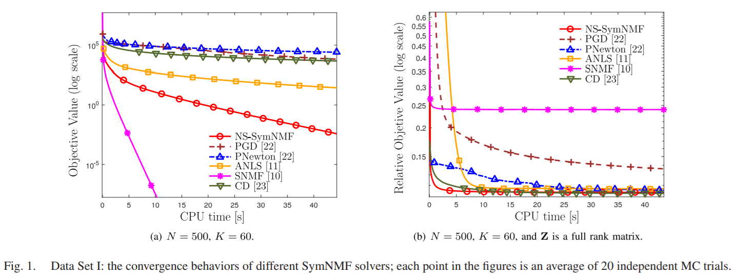
Results on Random Symmetric Matrices
They randomly generate two types of symmetric matrices, one is low rank and another is full rank.

Slide 19
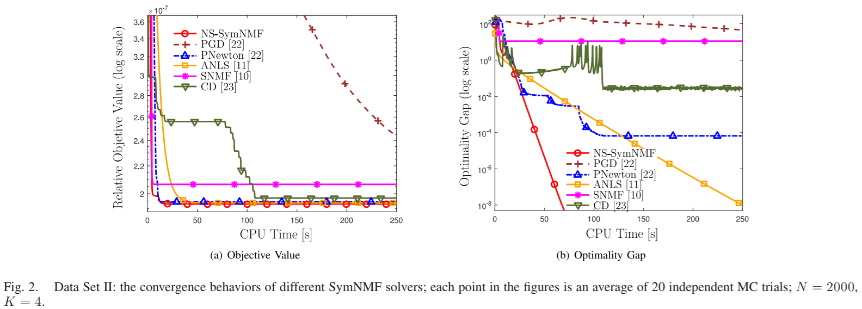
Results on Adjacency Matrices
They think one important application of SymNMF is graph partitioning.

Slide 20
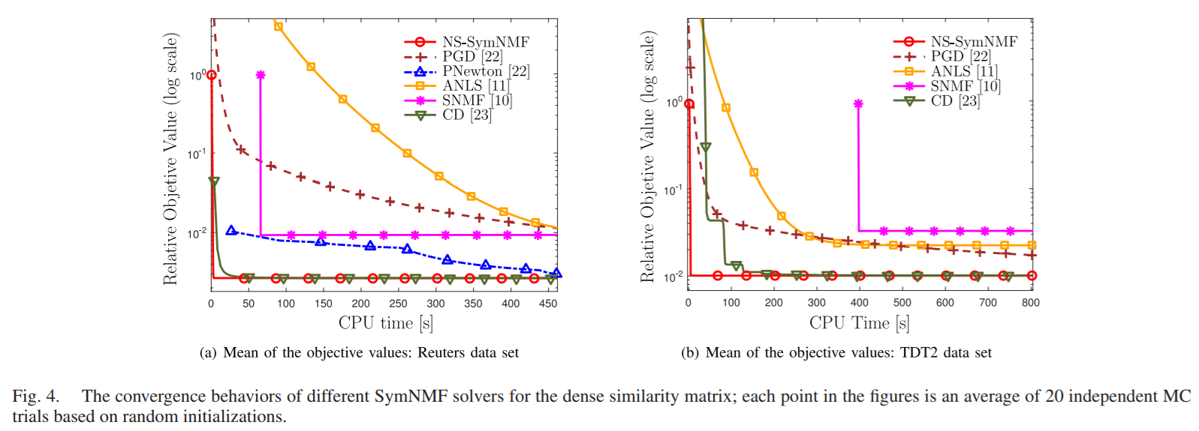
Results on Real Data: Dense Similarity Matrix
They apply algorithm on clustering applications.

Slide 21
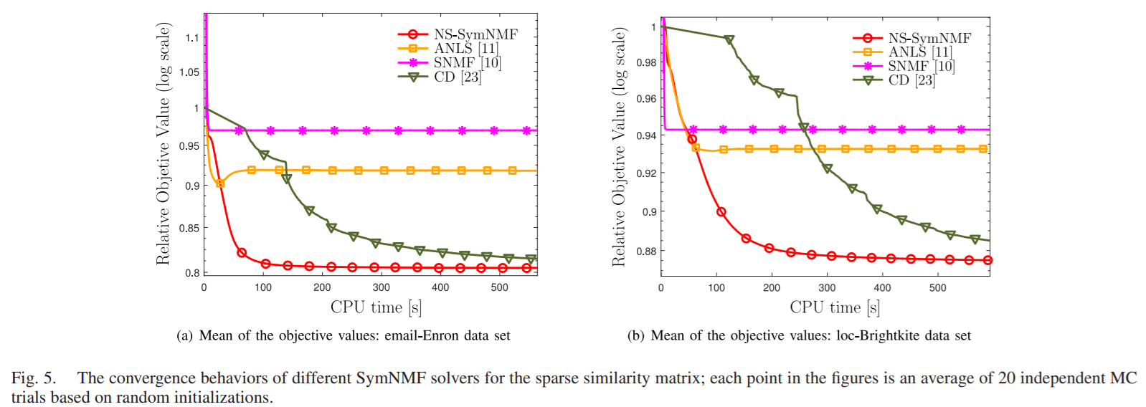
Results on Real Data: Sparse Similarity Matrix
They apply algorithm on clustering applications.

Slide 22
Conclusion
They design a nonconvex splitting SymNMF algorithm, which converges to the set of KKT points with a global sublinear rate. It is the first SymNMF solver that possesses global convergence rate guarantees.
The main idea is to relax the symmetry requirement at the beginning and gradually enforce it as the algorithm proceeds.
They provide a set of easily checkable sufficient conditions that characterize the global and local optimality of the solutions. It will converges not only to the set of KKT points but to a local optimal solution as well with high probability.

